Slide 1
Guest Lecture: Vanderbilt LGBTQ+ Policy Lab and How Economists Think About LGBTQ+ People Josh Martin (he/him) Postdoctoral Researcher Vanderbilt LGBTQ+ Policy Lab Center for Research on Inequality & Health GSS 1160 Sex & Society March 4, 2024

Slide 2
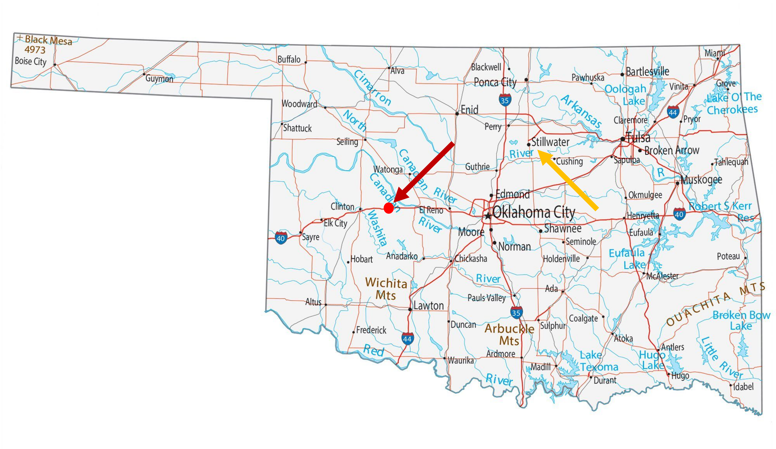

Slide 3
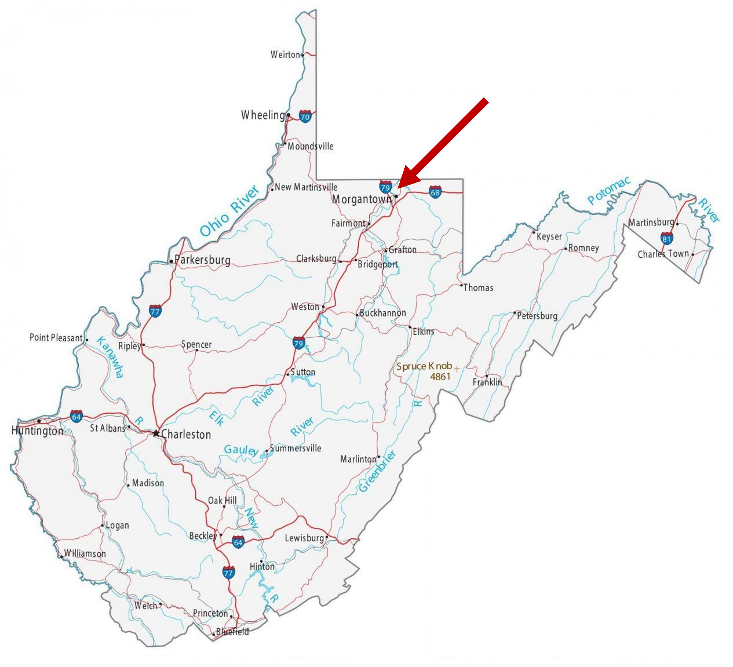


Slide 4

LGBTQ+ People: Phrasing
I study the Economics of LGBTQ+ individuals
Occasionally “SGM” will be used in academic settings
Sexual and/or Gender Minority Individuals
Informally and amongst allies, “queer” is occasionally used as a substitute

Slide 5
LGBTQ+ People are at the Center of Major Social Policy Debates
About marriage, employment, healthcare, etc.

Slide 6
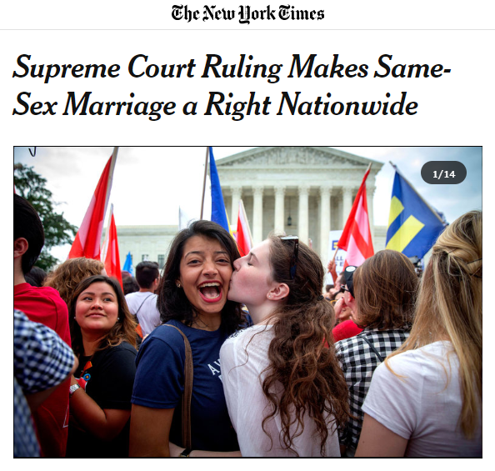

Slide 7
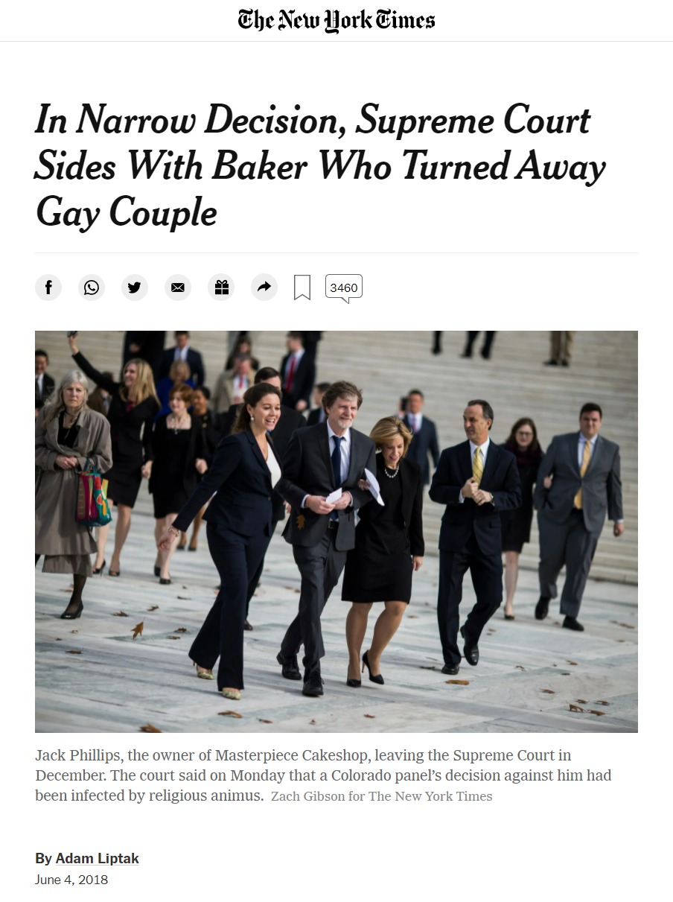

Slide 8
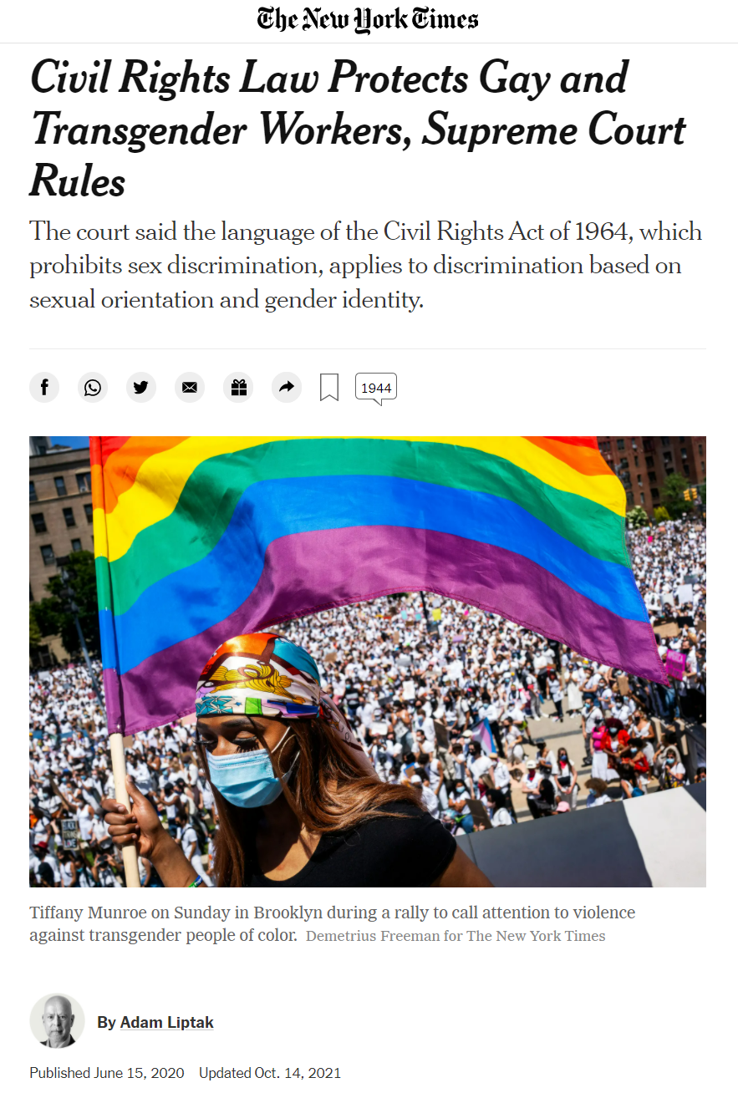

Slide 9
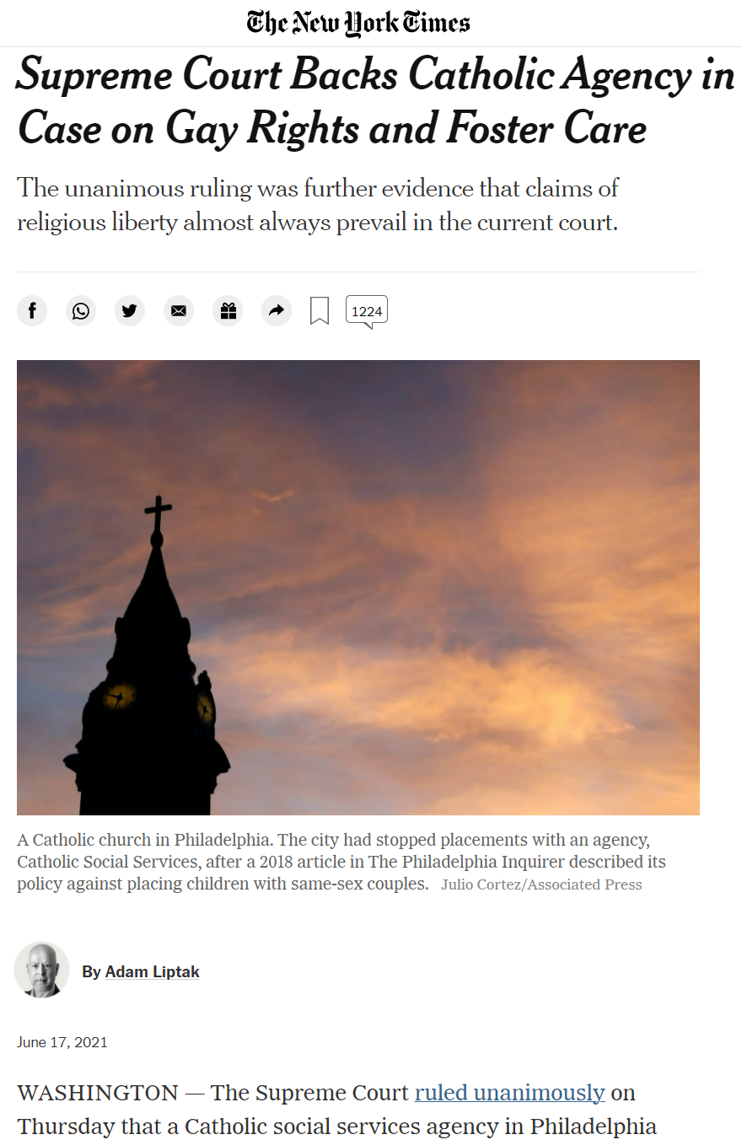

Slide 10
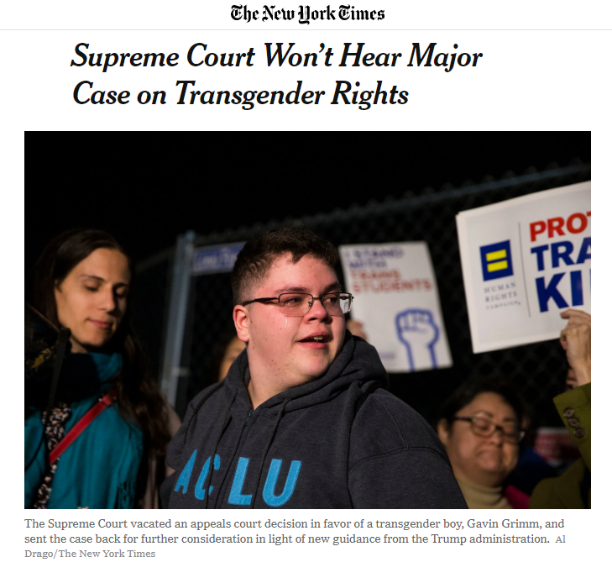
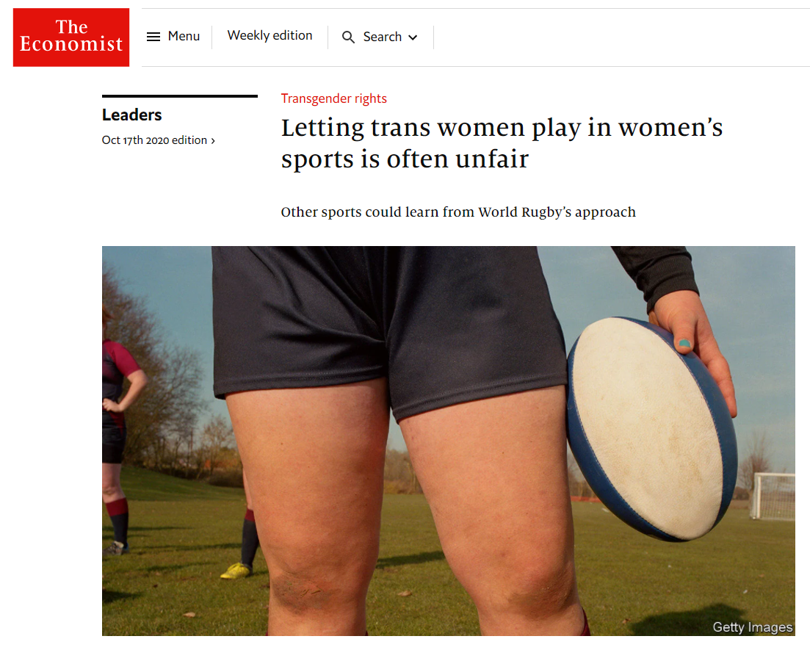
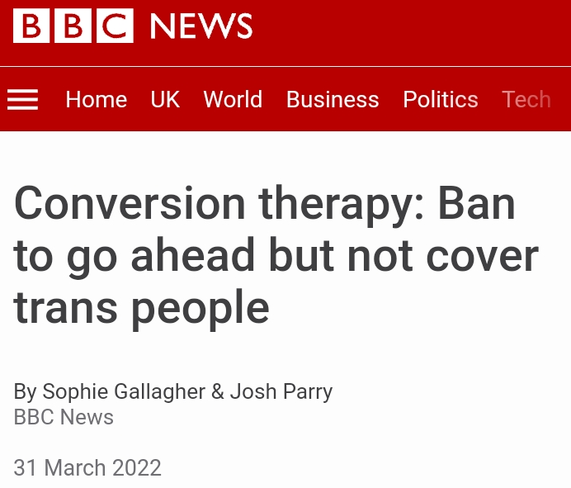
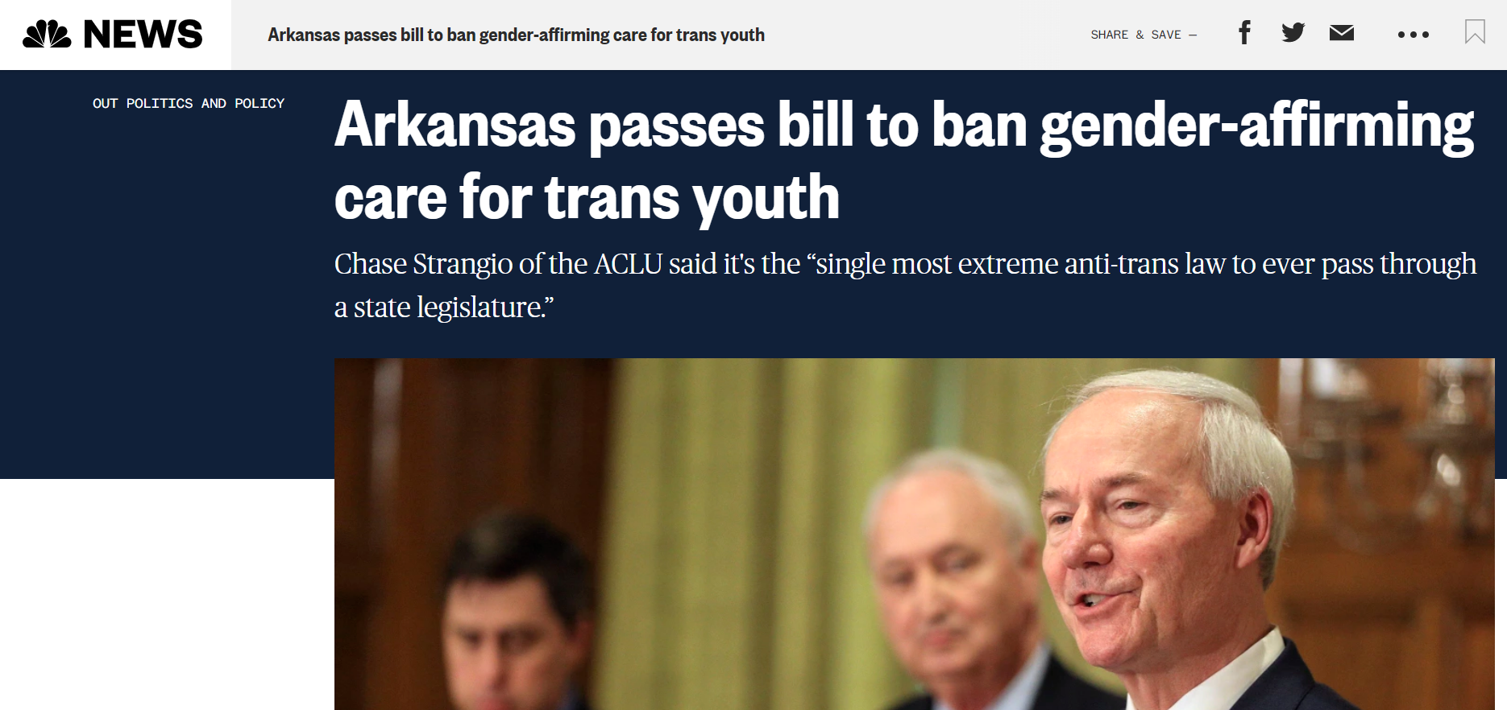
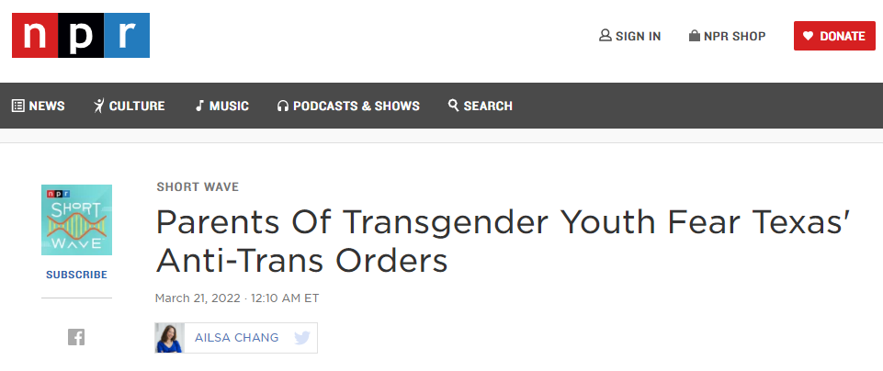

Slide 11
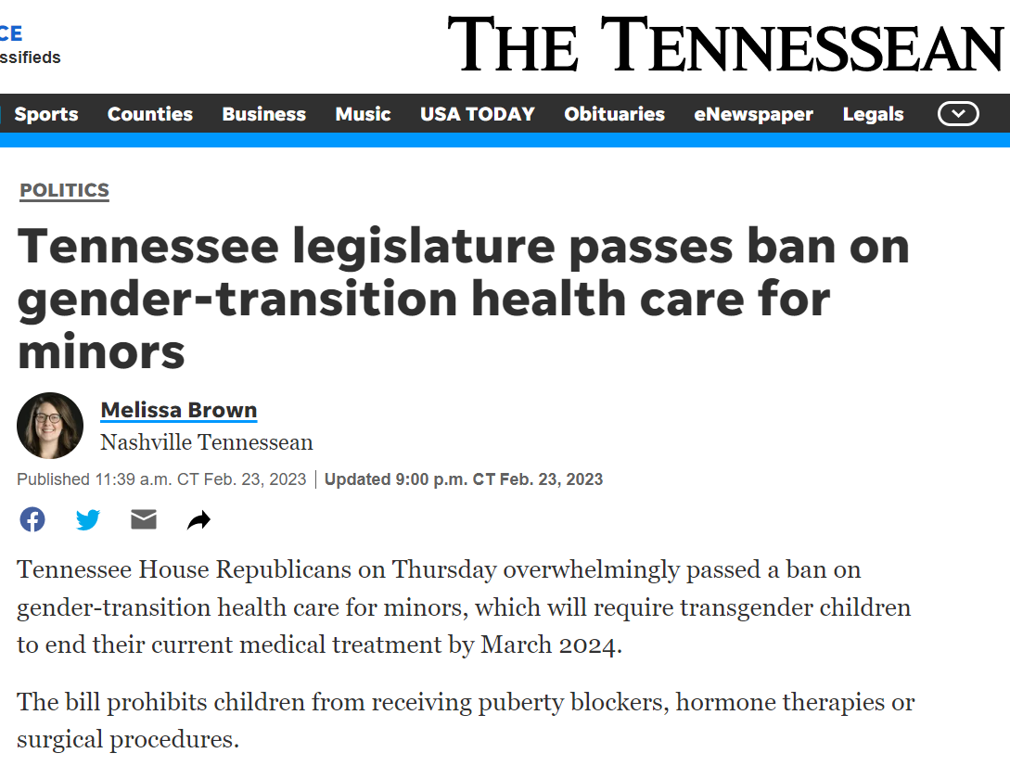

Slide 12
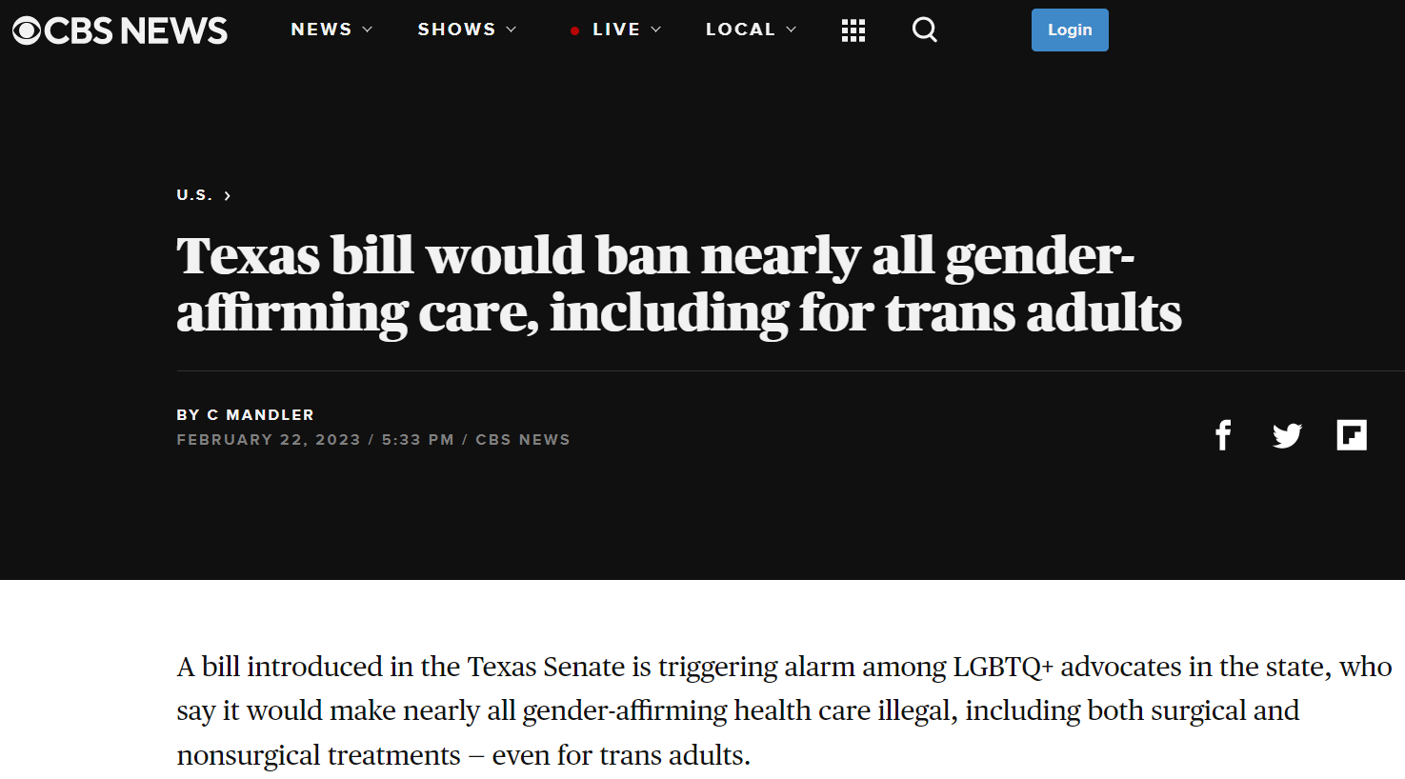

Slide 13
The Vanderbilt LGBTQ+ Policy Lab

Slide 14

2015

Slide 15
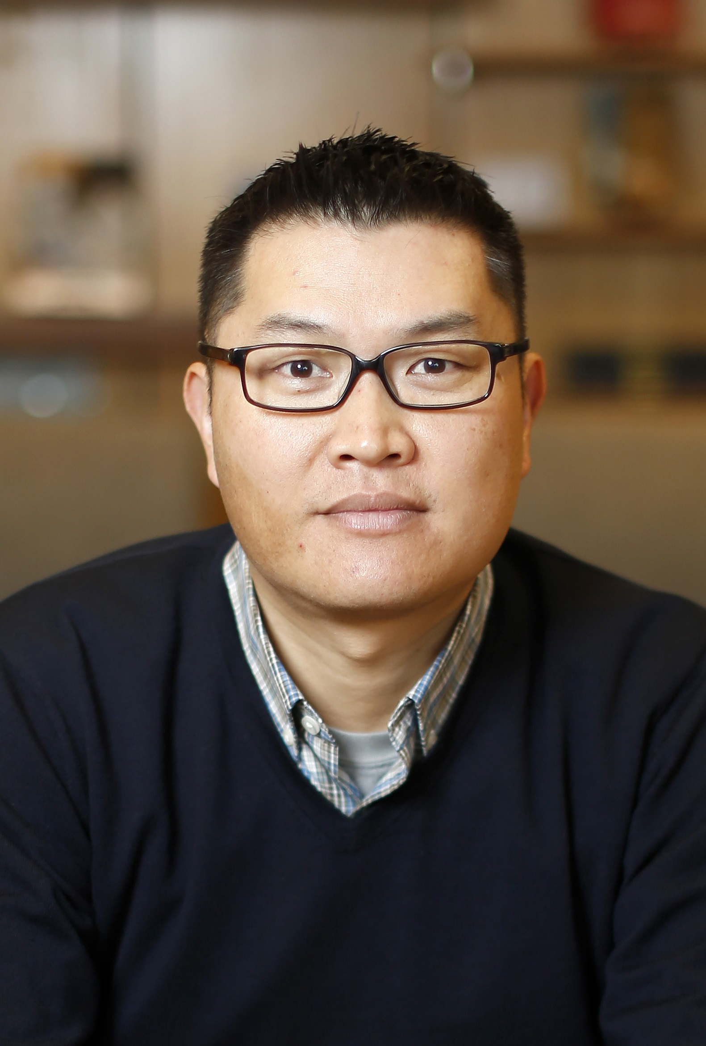
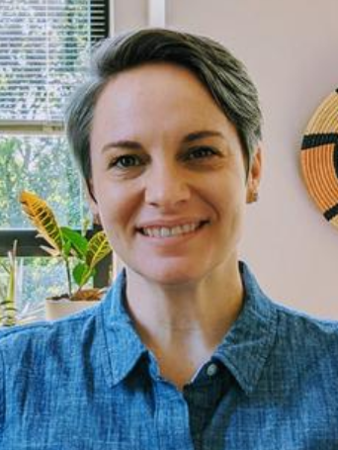


Kitt Carpenter, Economist, Director
Tara McKay,
Sociologist,
Associate Director
Gilbert Gonzales,
Health Services Researcher, Associate Director

Slide 16
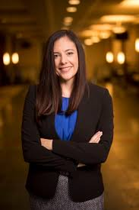
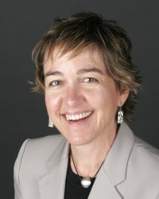
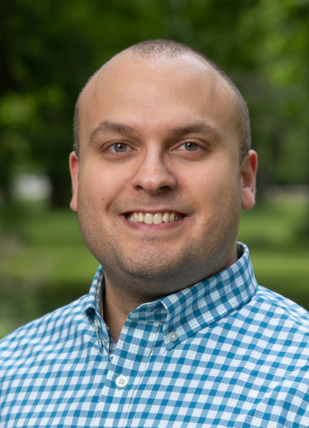
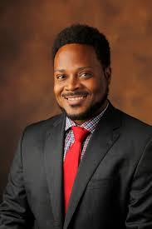
Kitt Carpenter, Economist, Director
Tara McKay,
Sociologist,
Associate Director
Gilbert Gonzales,
Health Services Researcher, Associate Director
Jessica Clarke, Legal Scholar
Ellen Armour, Divinity Scholar
Luis Leyva,
Education Scholar
Matthew Shaw, Legal Scholar

Slide 17
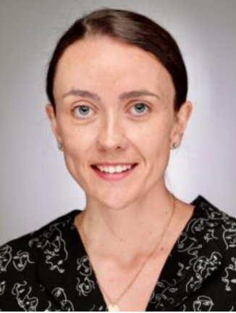
Kitt Carpenter, Economist, Director
Tara McKay,
Sociologist,
Associate Director
Gilbert Gonzales,
Health Services Researcher, Associate Director
Kirsty Clark, Social & Psychiatric Epidemiologist,
Associate Director
Jessica Clarke, Legal Scholar
Ellen Armour, Divinity Scholar
Luis Leyva,
Education Scholar
Matthew Shaw, Legal Scholar

Slide 18
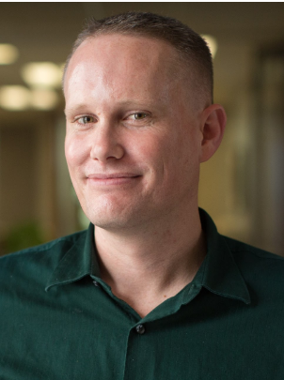
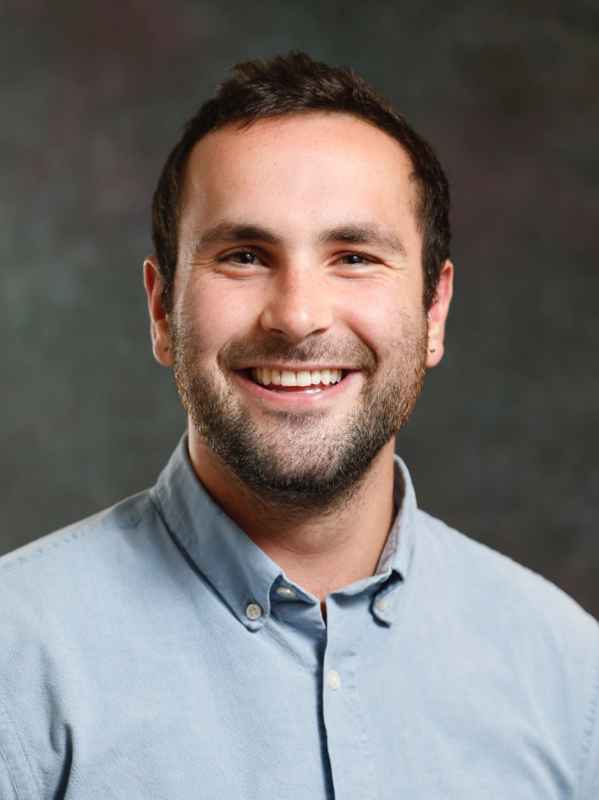





Kitt Carpenter, Economist, Director
Tara McKay,
Sociologist,
Associate Director
Gilbert Gonzales,
Health Services Researcher, Associate Director
Kirsty Clark, Social & Psychiatric Epidemiologist,
Associate Director
Marcus Dillender, Economist
Jessica Clarke, Legal Scholar
Lawrence Stacey, Sociologist
João Tampellini, Economist
Nathaniel Tran, Health Policy
Laura Nettuno, Economist
Hasan Shahid, Economist
Josh Martin, Economist
PhD students
Postdoctoral Researchers
● 30+ undergraduate trainees who have gone on to graduate training (JD, MD, PhD) and employment at Yale, Florida State, Fenway
● Graduate & postdoc mentees placed at Dartmouth, Johns Hopkins, Exeter, Trinity, Notre Dame, RAND, CDC
● Started with 3 folks ➔ team of ~15 + 2 full-time staff in 7 years
Ellen Armour, Divinity Scholar
Luis Leyva,
Education Scholar
Matthew Shaw, Legal Scholar

Slide 19


Slide 20
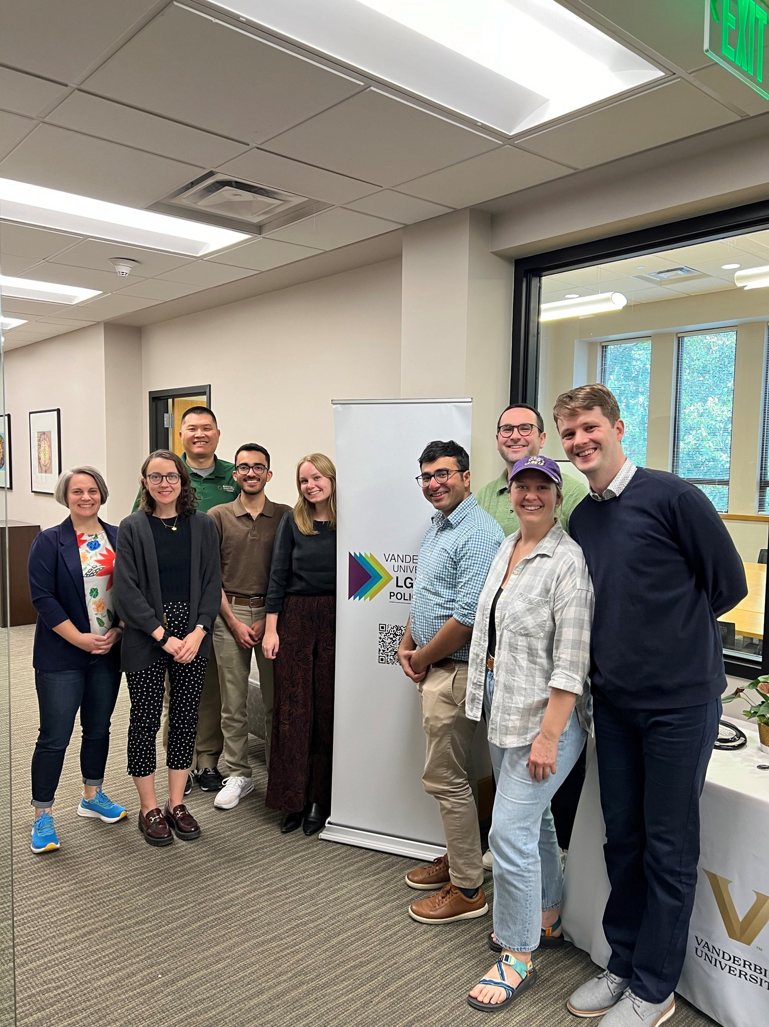

Slide 21
SCHOLARSHIP
● Published LGBTQ+ health and policy scholarship in JAMA, JAMA Psychiatry, JAMA Pediatrics, NEJM, Harvard Law Review, Demography, LGBT Health, BMC Open, JPAM
● Invited to give talks at Stanford, Columbia, Cornell, Indiana, Maryland, UNC, Census, etc.
● Research accepted for presentation at AEA, ASA, APA, APPAM, APHA, SRCD, AADA, AABCT

Slide 22
SCHOLARSHIP
● Published LGBTQ+ health and policy scholarship in JAMA, JAMA Psychiatry, JAMA Pediatrics, NEJM, Harvard Law Review, Demography, LGBT Health, BMC Open, JPAM
● Invited to give talks at Stanford, Columbia, Cornell, Indiana, Maryland, UNC, Census, etc.
● Research accepted for presentation at AEA, ASA, APA, APPAM, APHA, SRCD, AADA, AABCT
GRANTS
● Over $4 mil internal funding
● Over $6 mil external funding
● R01s from NIA, RWJF
● K01 from NIMH
● R21s from NIMHD, AHRQ, RWJF
● Applied for > $6 mil from NIH in past 12 mos on SGM health
● Policy Lab active in reviewing NIH grants in SGM health

Slide 23
SCHOLARSHIP
● Published LGBTQ+ health and policy scholarship in JAMA, JAMA Psychiatry, JAMA Pediatrics, NEJM, Harvard Law Review, Demography, LGBT Health, BMC Open, JPAM
● Invited to give talks at Stanford, Columbia, Cornell, Indiana, Maryland, UNC, Census, etc.
● Research accepted for presentation at AEA, ASA, APA, APPAM, APHA, SRCD, AADA, AABCT
TRAINING
● UG courses on LGBTQ+ health; LGBTQ+ policies; numerous grand rounds and guest lectures
● Awarded multiple NIH diversity training supplements for postdocs, PhD students, UGs
● Grad student trainee Tran R36 imminent
● Postdoc Barbee awarded 2022 Vanderbilt Postdoc of the Year
GRANTS
● Over $4 mil internal funding
● Over $6 mil external funding
● R01s from NIA, RWJF
● K01 from NIMH
● R21s from NIMHD, AHRQ, RWJF
● Applied for > $6 mil from NIH in past 12 mos on SGM health
● Policy Lab active in reviewing NIH grants in SGM health

Slide 24
SCHOLARSHIP
● Published LGBTQ+ health and policy scholarship in JAMA, JAMA Psychiatry, JAMA Pediatrics, NEJM, Harvard Law Review, Demography, LGBT Health, BMC Open, JPAM
● Invited to give talks at Stanford, Columbia, Cornell, Indiana, Maryland, UNC, Census, etc.
● Research accepted for presentation at AEA, ASA, APA, APPAM, APHA, SRCD, AADA, AABCT
TRAINING
● UG courses on LGBTQ+ health; LGBTQ+ policies; numerous grand rounds and guest lectures
● Awarded multiple NIH diversity training supplements for postdocs, PhD students, UGs
● Grad student trainee Tran R36 imminent
● Postdoc Barbee awarded 2022 Vanderbilt Postdoc of the Year
COMMUNITY IMPACT
● Provide research evidence to advocates in response to anti-LGBTQ+ legislation
● Regularly host and/or co-sponsor public talks, discussions, and events for Vandy & Nashville
● Presence at Atlanta Black Pride, Nashville Pride, Franklin Pride
● Active partners with Vanderbilt administration on EDI
GRANTS
● Over $4 mil internal funding
● Over $6 mil external funding
● R01s from NIA, RWJF
● K01 from NIMH
● R21s from NIMHD, AHRQ, RWJF
● Applied for > $6 mil from NIH in past 12 mos on SGM health
● Policy Lab active in reviewing NIH grants in SGM health

Slide 25
Questions about the Policy Lab?

Slide 26
How Economists Think About Sexual Orientation and Gender Identity

Slide 27
Roadmap
1. Economic theories on LGBTQ+ people
2. Economic data on LGBTQ+ people
3. Why you might care
4. Brief research snapshot
Please feel free to ask questions!

Slide 28
Theory: What does economic theory tell us about LGBTQ+ people?
If LGBTQ+ people have different economic outcomes, is that because of different preferences or different constraints?
Becker model of discrimination
Taste-based
Statistical Discrimination
Does discrimination exist? If so, why? What drives it?

Slide 29
Data: How do we know what we know about LGBTQ+ people?

Slide 30
Data: How do we know what we know about LGBTQ+ people?
Qualitative interviews
Talk with people at Pride festivals, LGBTQ+ community organizations, gay bars, etc.

Slide 31
Data: How do we know what we know about LGBTQ+ people?
Qualitative interviews
Talk with people at Pride festivals, LGBTQ+ community organizations, gay bars, etc.
Quantitative Surveys
Ask people directly about LGBTQ+ status
Infer LGB status via household relationships

Slide 32
Data: How do we know what we know about LGBTQ+ people?
Qualitative interviews
Talk with people at Pride festivals, LGBTQ+ community organizations, gay bars, etc.
Quantitative Surveys
Ask people directly about LGBTQ+ status
Infer LGB status via household relationships
Economists mostly do this…

Slide 33
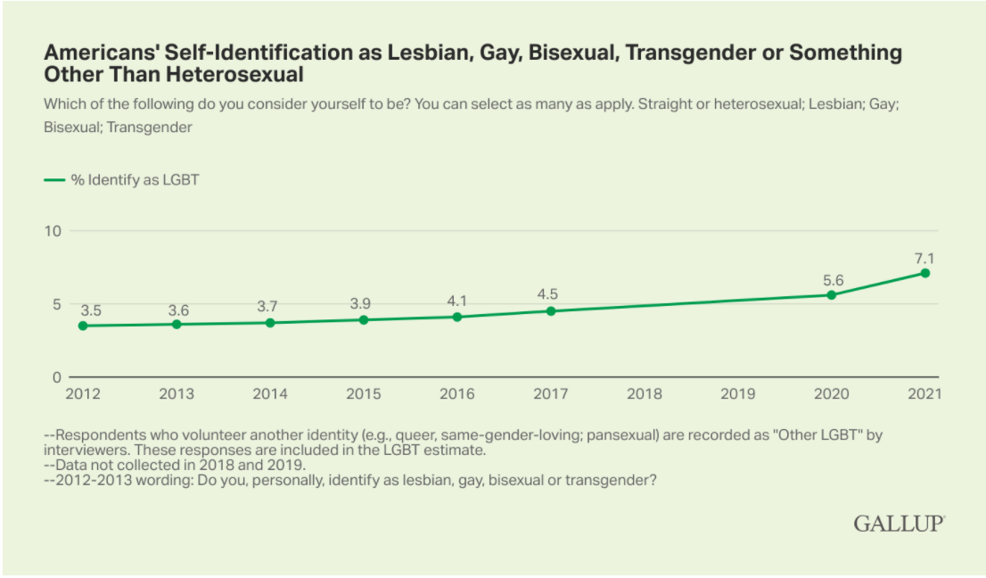

Slide 34
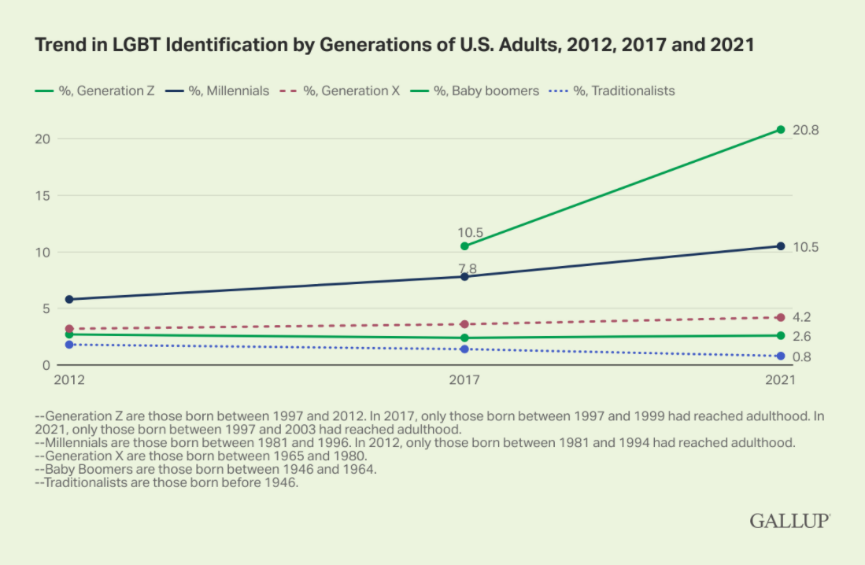

Slide 35
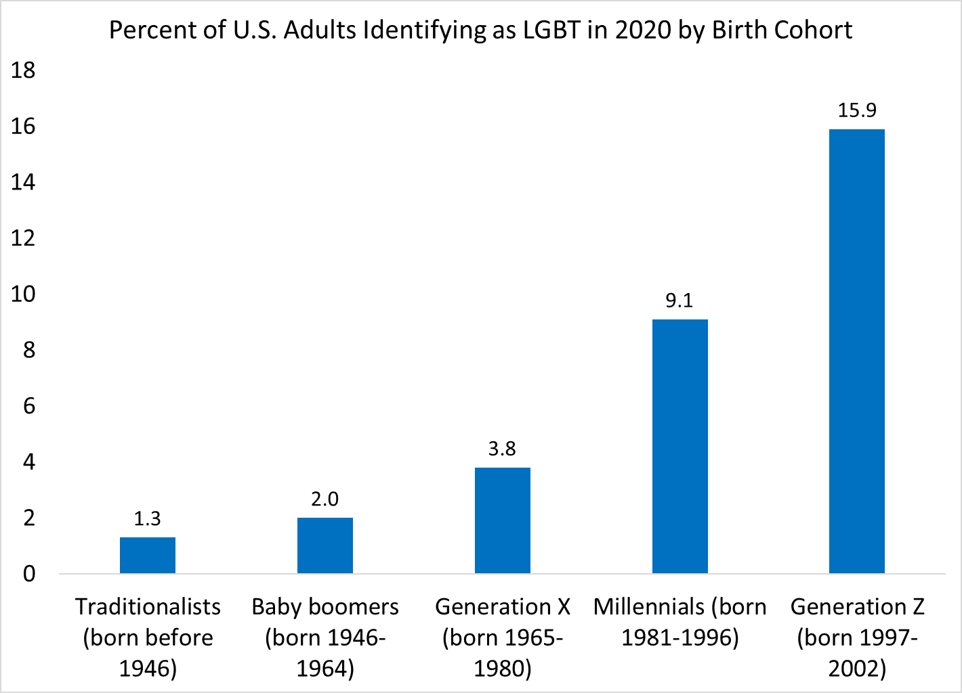
LGBTQ+ population skews young
Source: Gallup

Slide 36
What the data show: LGB
Gay men earn less than similar straight men
Lesbian women earn more than straight women
Bisexual people earn less than straight people
This is found in surveys and experiments
This is found across many countries & time periods
Some evidence this is improving over time

Slide 37
What the data show: T/NB
Non-cisgender folks have much worse economic outcomes than cisgender folks.
Especially for trans women.
This evidence is only from two US surveys.
Soon we will have evidence from Netherlands, Canada, UK, NZ

Slide 38
Why you might care
Increasing shares identify as LGBTQ+
LGBTQ+ people consume
LGBTQ+ employment discrimination is illegal
LGBTQ+ get more human capital
Productivity costs of concealment
Diverse teams do better
Punchline: discrimination is costly.

Slide 39



Slide 40
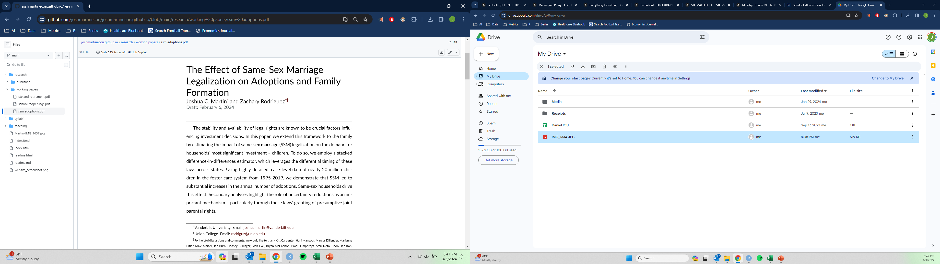


Slide 41
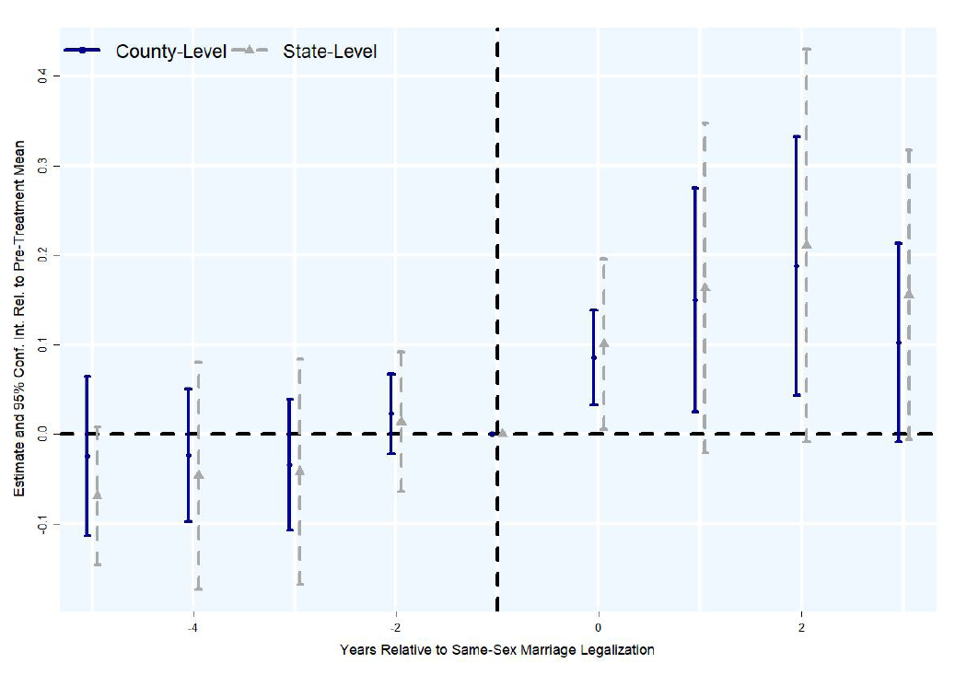

Slide 42
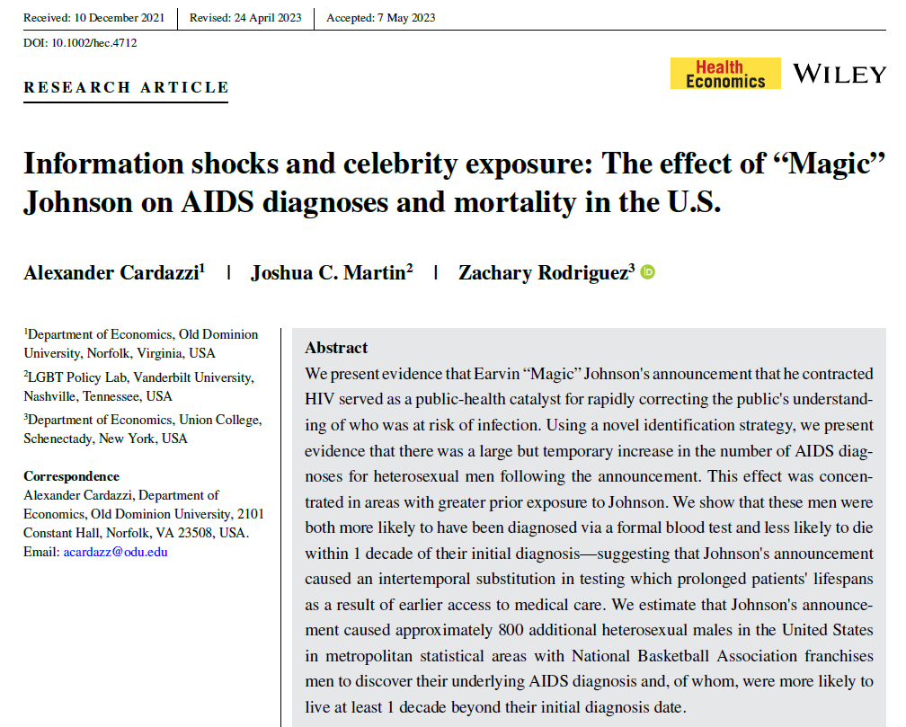




Slide 43
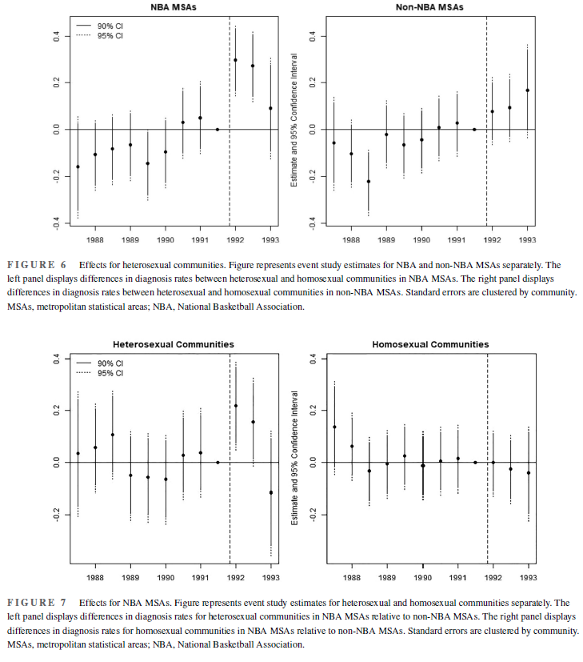

Slide 45
Questions?
Thank you!
joshua.martin@vanderbilt.edu

